Slide 1


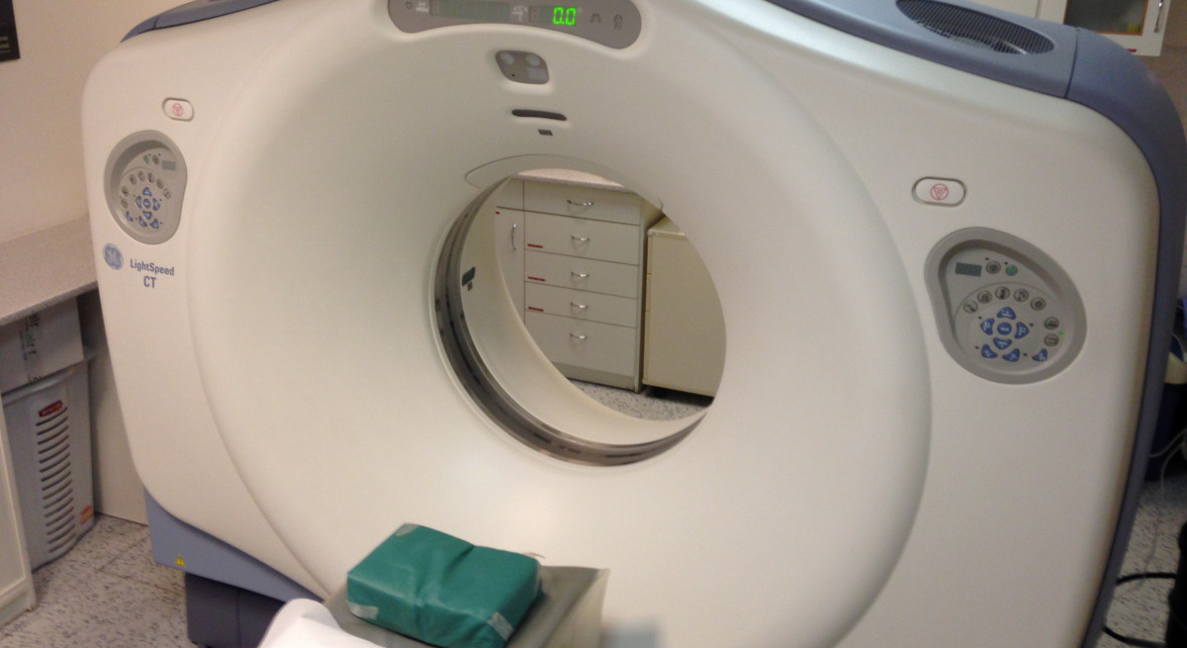
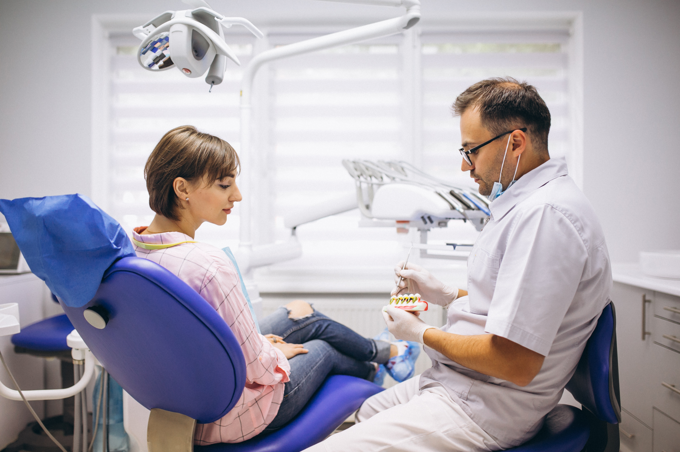
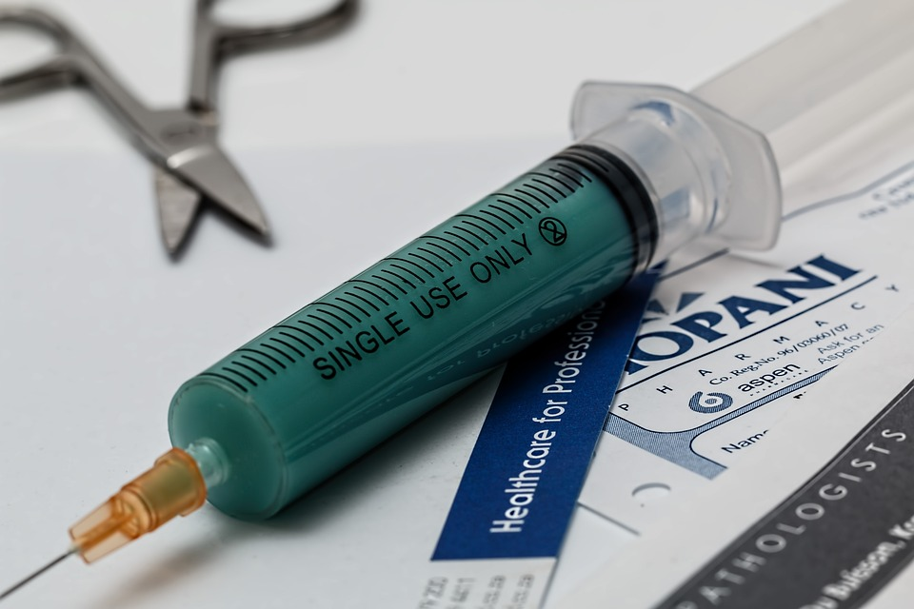
Automated customer care system for hospital
GROUP 2

Slide 2
Presented by
Name | Id
ALIMUL MAHFUZ TUSHAR | 19-39831-1
EHSANUZZAMAN SHAWON | 19-39823-1
JIHAD SHAHARIAR JOY | 19-40068-1
AHMED, MD. KAUSHIQ | 18-37891-2
REYA, RUBINA ISLAM | 19-39811-1

Slide 3
Outline
Introduction
Problem statement
Propose solution
Requirements
Product vision and scope
Context and use case diagram
Conclusion
Constraints

Slide 4
Introduction
As the population in our country increasing more rapidly ,the pressure from patient is increasing day by day. The hospital authority is being unable to give proper service to the patient. An online customer care system for doctor appointment and diagnostic will be helpful for both hospital management and patient. This addition to the hospital system will revolutionize the customer care issue faced by the authority on a regular basis.

Slide 5

Problem Statement
The hospital customer care system is unable to cope with the high volume of telephone calls. An online system for doctor appointment and diagnostic needs to be developed.

Slide 6
Proposed Solution
An online appointment system that eliminate the traditional phone-based appointment system. A customer can login or without login check available doctors or diagnostic facilities can book and appointment in an available slots. Doctor can also see his/her upcoming patients list and pervious history of any patients

Slide 7
Business Requirements
Here patient needs an auto call system, because of that they can contact hospital properly
To build the auto call system we can develop a patient care or web base portal by which patient can contact hospital properly
We can use medical service portal by using that a patient can take an appointment or cancel the appointment timely

Slide 8

User Requirements
Multiple Sign-Up Options.
Simple Log-In interface.
Two-step verification system on users choice.
Easy to use/understand user panel/dashboard.
Search, view profile and view rating of Doctor.
Make, cancel, view and print appointments.
View diagnostics & available services
Better Profile management and Payment.

Slide 9

Functional Requirements
Customer, doctor should login to the system.
Customer should be able to check his or her appointment.
Customer could cancel his or her appointment.
Customer should be able to see his appointments.

Slide 10
System Requirements
Apache version 2.0
NGNIX version 3.0
PHP version 8.0
MySQL Database
Server OS windows 10 or Linux 20.02 enterprise edition or above
Android version minimum 11.0 or later

Slide 11

Vision and scope
The authority's ongoing struggle with providing excellent customer service will be completely transformed by this addition to the hospital system. The load that was too much for the old system, which consisted of the call-receivers on the other end of the customer service, will be reduced by the automation of the bulk of calls and the interactivity brought by the product. The project's scope includes ensuring efficient information exchange between the IT, Service, and IT departments, as well as the soon-to-be created Customer Care system.

Slide 12
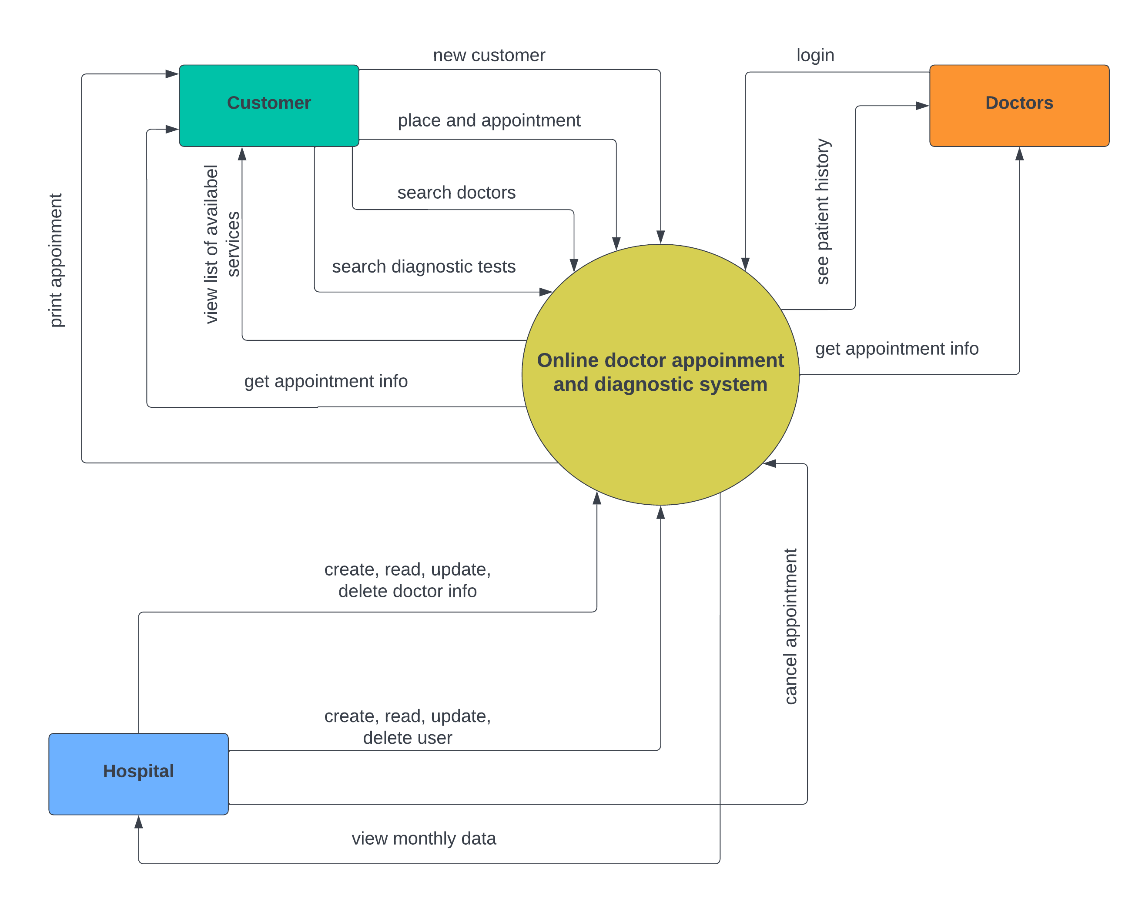
Context and use case diagram (1/2)

Slide 13
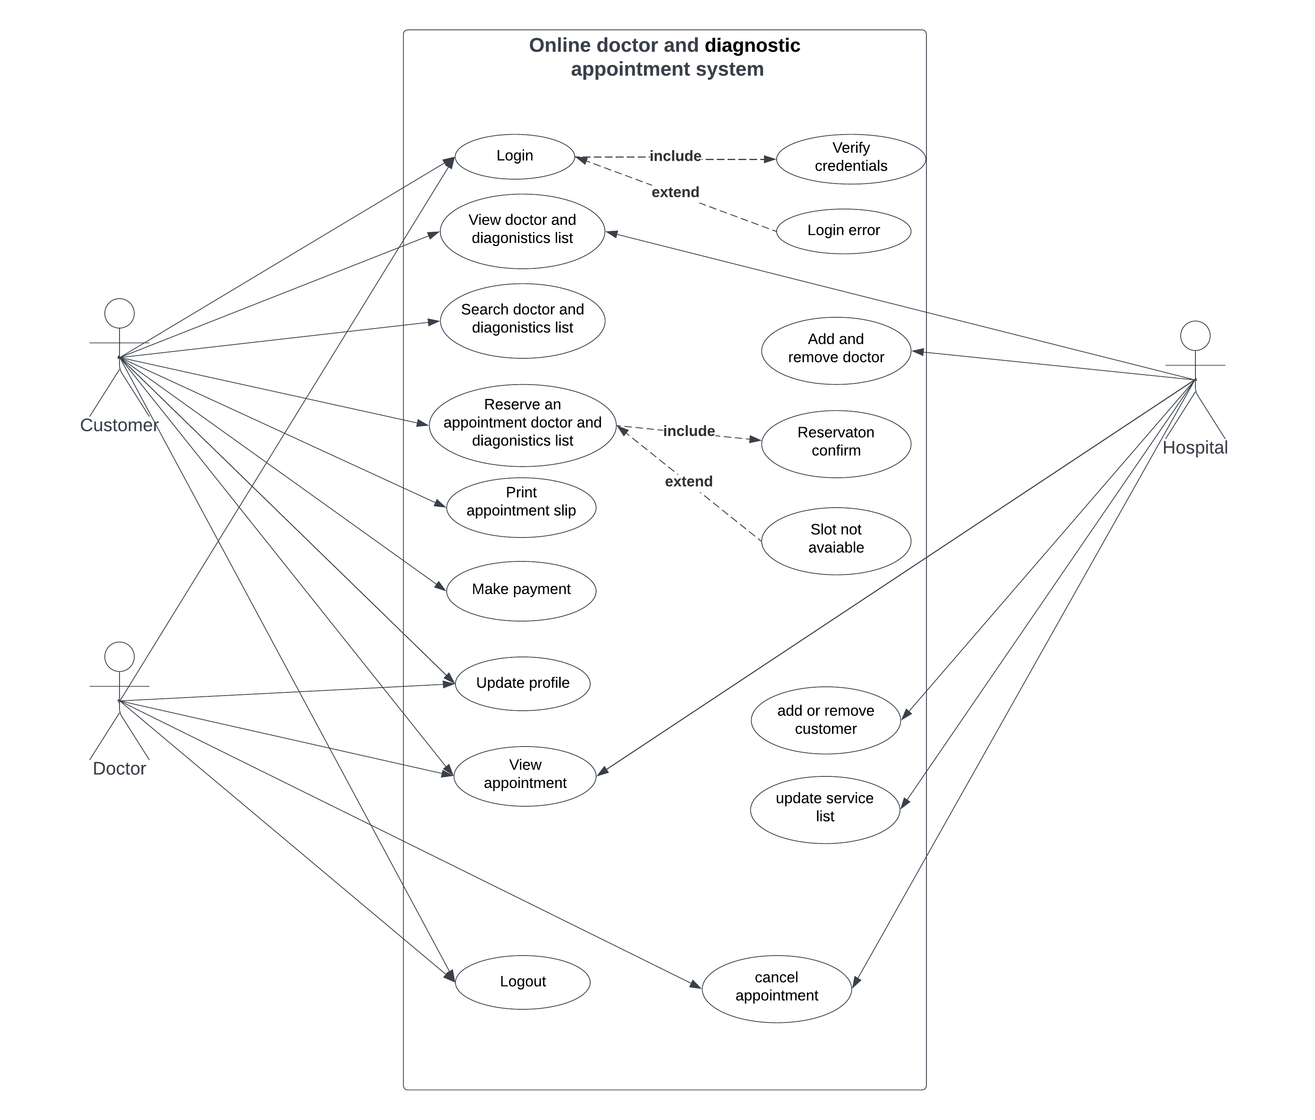
Context and use case diagram (2/2)

Slide 14
Constraints
Short time period.
Errors and bugs.
Missing Requirements.
Anyone can create an account.
One user with multiple accounts.
Unnecessary accounts with un-ethical users
Elderly patient's limitations

Slide 15
Conclusion
The system will be revolutionary for overpopulated health care system. Specially in Bangladesh where hospital are limited. Besides, phone appointment is labor intensive work that come with additional cost for hospital. Automated system will eliminate this issues and provide a fast and efficient system.

Slide 16
Thank You

